Slide 1


CampusConnect College ERP Portal
Presented By: Jai Soni
Reg. No: 23MCAN0022

Slide 2
Introduction
What is CampusConnect?
A robust ERP portal designed for educational institutions.
Aims to streamline academic and administrative operations.
Purpose:
To offer a centralized platform for efficiently managing student and staff information.

Slide 3
Problem Definition
Challenges:
Inefficiencies in manual record-keeping.
Errors in tracking student progress and staff schedules.
High risk of data loss with paper-based systems.
Lack of centralized communication and data management.
Objective:
Develop an automated, secure, and unified solution to overcome these challenges.

Slide 4
Functional Objectives
Core Functions:
Efficient student and staff information management.
Real-time attendance monitoring.
Integrated notifications management for smooth communication.
Non-Functional Goals:
Strong data security and controlled user accessibility.
Scalable to accommodate large datasets.
Intuitive and user-friendly interface for seamless usability.

Slide 5
System Design
Technologies Used:
Frontend: HTML, CSS, JavaScript
Backend: Django (Python Framework)
Database: MySQL for secure and optimized data storage
Key Features:
Centralized data management.
User role segmentation (Students, Staff, Administrators).
Integrated task and course management.

Slide 6
Development Lifecycle
Requirement Analysis – Identifying system needs.
System Design – Structuring the database schema and UI/UX.
Development – Implementing frontend, backend, and modules.
Testing – Conducting functional and security tests.
Deployment – Rolling out and gathering feedback

Slide 7
Core Features
Attendance Management: Real-time student and staff tracking.
Course Management: Assignments, curriculum updates, and batch tracking.
Notifications: Task alerts, deadlines, and important updates.

Slide 8
Testing & Validations
Unit Testing: Validating individual features such as attendance and reporting.
Integration Testing: Ensuring smooth interaction between different system modules.
Security Testing: Implementing data encryption and secure user access measures.

Slide 9
Limitations
Internet Dependency: Some features require a stable connection.
Limited Offline Access: Some functionalities may not be available offline.
Future Scope: Advanced analytics will be integrated in upcoming updates.

Slide 10
Future Enhancements
Mobile application integration for improved accessibility.
AI-driven analytics for performance tracking.
Advanced visual reports with interactive dashboards.
Offline functionality with real-time synchronization.

Slide 11
Conclusion
Summary: CampusConnect is a secure, efficient, and centralized ERP solution designed to streamline educational institution processes.
Key Focus: Automating and integrating academic and administrative tasks.
Future Vision: Continuous improvements to enhance scalability and functionality.

Slide 12
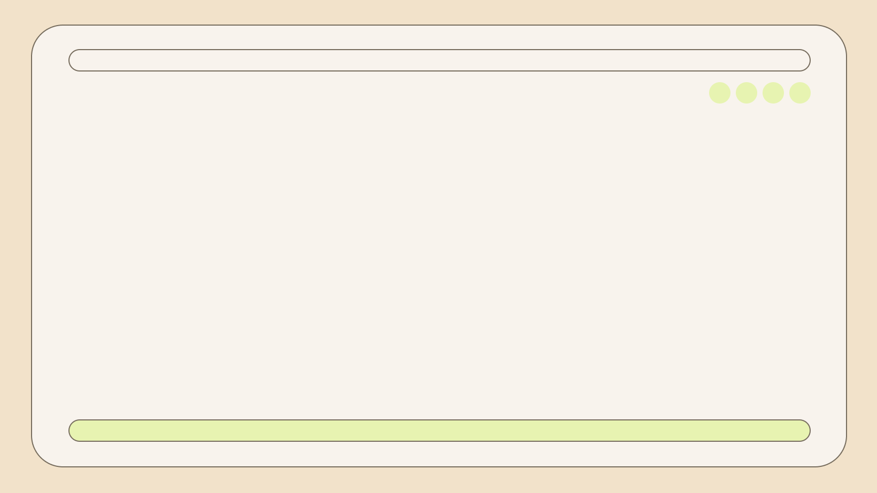
Thank You
Presented By: Jai Soni
Reg. No: 23MCAN0022

